Slide 1
Trust Me, I’m A Welder!
And I did all the welding on this PowerPoint…
Morgan Perry
CLF2301, CLF2303, CLF2349
Notes:
Description: CLF2301, CLF2303, CLF2349- An introduction for students to help them understand the importance of welding shop safety and how to correctly identify and classify electrodes.

Slide 2
To The Teacher:
This PowerPoint covers the basics in the Core Curriculum standards for CLF2301, CLF2303, CLF2349
Upon completion of this Welding Safety and Electrode Classification lesson, the student will be able to:
  (G-1) Pass a shop safety test
  (G-10) Demonstrate the proper use of arc welding equipment
  (G-3) Be familiar with the American Welding Society (AWS) classification for electrodes
Evaluation of knowledge:
  A passing score on a safety test, unit exam or quiz by the instructor
  Correct identification of electrodes
Notes:
Welding Safety
Topic Objectives: Upon completion of this lesson, the student will be able to:
Learning Outcome: #:
(G-l) - Pass a safety test and demonstrate proper use of arc welding equipment.
(G-10) - Change lens and head gear on a helmet.
Special Material and Equipment: Arc welding helmet, leather gloves, aprons, coveralls, strikers, safety test, slag hammer, safety goggles
Evaluation: A passing score on the safety test. Unit exam or quiz by the instructor.
Electrode Classification
Topic Objectives: Upon completion of this lesson, the student will be able to:
Learning Outcome: #:
(G-3) - Be familiar with the American Welding Society (AWS) classification for electrodes.
Special Materials and Equipment: Samples of electrodes
Evaluation: Correct identification of various electrodes

Slide 3
Activities:
Used to enhance and solidify the knowledge and skills learned during this lesson.
Welding Safety Activities CLF2301, CLF2349:
  Practice changing lenses and head gear in arc welding helmets.
  Practice identifying and handling arc welding equipment, making sure that all safety procedures are followed and that suitable clothing is being worn.
Welding Electrodes Activities CLF2303, CLF2349:
  Select six different arc electrodes and outline in writing each of their characteristics.
  Weld a bead with each of the six arc electrodes and describe in writing how each electrode reacts during the welding process.
  Weld various beads using DC straight, DC reverse, and AC type currents.

Slide 4
Today’s Objectives:
What is Arc Welding
Five Types of Arc Welding
Welding Equipment
Personal Protective Equipment
Eye and Face Protection
Important Safety Rules
How to Properly Classify Electrodes

Slide 5
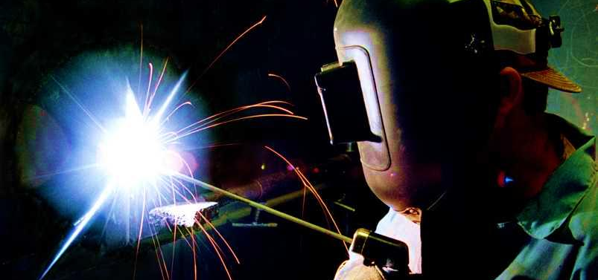
Arc Welding
Arc welding is when two metals are joined together through the use of an electric arc, or current, between a coated metal electrode and a base metal.

Slide 6

The Five Types of Arc Welding
SMAW-Shielded Metal Arc Welding
GTAW/TIG-Gas Tungsten Arc Welding
GMAW-Gas Metal Arc Welding
FCAW-Flux Core Arc Welding
SAW-Submerged Arc Welding
Click here if video does not work!
Notes:
Arc welding is a popular form of welding due the low cost of the process. The process begins with a device that gives off an electric current. This device can differ greatly from process to process yet it always enables electric current to move through materials that without the device, would be considered non-conductive. It is called ‘arc welding’ because an electrical current is created between the welding device and the materials to be welded which at times gives an arch like appearance. The first basic form of arc welding was invented in the year 1802. Today, many other subcategories of arc welding exist.
Shielded-Metal Arc Welding (SMAW) is also referred to as ‘stick welding’. This process is known to be the most popular and widely used processes in welding today. It is a manual welding process that is very simple and inexpensive to operate. The results often are not as ‘neat’ as other methods and molten splatter is a common occurrence.
Gas Tungsten-Arc Welding is considered to be one of the most difficult and time consuming of welding processes used today (along with Plasma Arc Welding). This is because it requires a great amount of focus and skill due to the small area of space between the ’arc’ of the flame and the material being welded. Though it is difficult, it produces extremely strong high quality welds when done correctly.
The process of Gas Metal Arc Welding (GMAW), created in the 1940’s, is another automatic welding process. This method consists of the use of a welding gun which automatically feeds the weld metal through the gun for use. The weld gun also automatically distributes a protective gas as a shield from the natural elements. This process saves a lot of time and is best for a large quantity of welding work.
Flux-cored welding was created and put into use in the early years of the 1950’s. Its purpose was to give another option to the popular use of ‘stick welding’. The Flux-Cored process is mostly used for projects that require fast speed as it is an automatic form of welding.
The Submerged Arc Welding process can only be used properly on materials containing high iron contents, such as stainless steel. The device used in this process can be automatic or semi-automatic making it a fairly fast welding process. While it is a fast process, the electrical arc must constantly be covered by ‘flux’ in order to protect the metal from the atmosphere during the welding process.

Slide 7
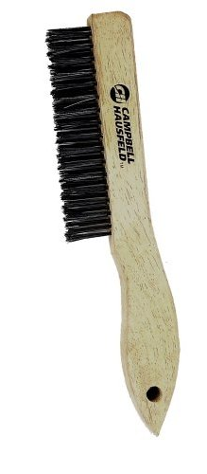
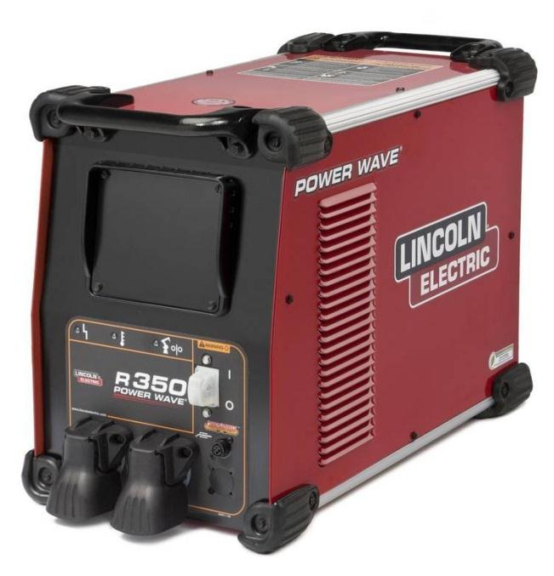
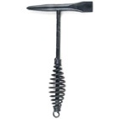
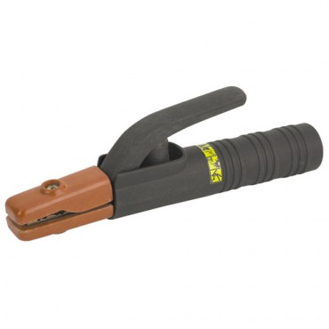
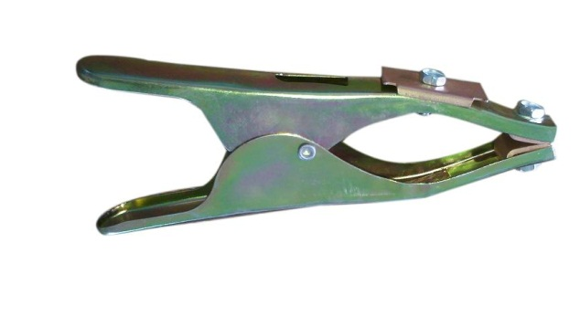
Welding Equipment
Power Supply
Ground Clamp
Electrode Holder/ Stinger
Slag Hammer
Wire Brush
Cables
Electrode
Tongs

Slide 8
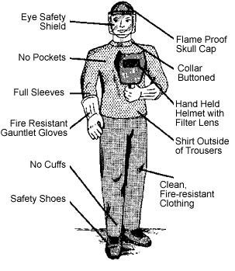
The Well Dressed Welder
Personal Protective Equipment
Leather welding gloves
Face and head protection
Leather, cotton or wool clothes
No pockets or cuffs
Close-toed, rubber soled boots
Long pants and sleeves
Notes:
Wear leather gloves with gauntlets and eye and face protection. The welder and all observers must wear welding helmets with a No. 10 or 12 filter lens. A welding cap or helmet with a hard hat is also recommended for head protection. When chipping slag or cleaning welds, wear a clear face shield or flip-up liftplate on the helmet.
Never wear synthetic fiber clothing. Synthetic fibers are highly flammable. Leather is the best at preventing burns, but wearing clothing made from wool or cotton is also fine for welding because of their relatively high flash points.
Never cuff your pants or wear a shirt with pockets. They can hold catch hot slag or embers coming from your work-piece.
Wear close-toed, rubber soled boots to help you retain traction, to protect your feet and to help prevent you from becoming part of the circuit.

Slide 9
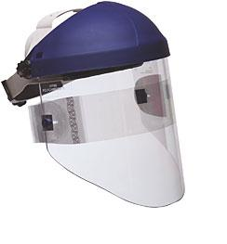
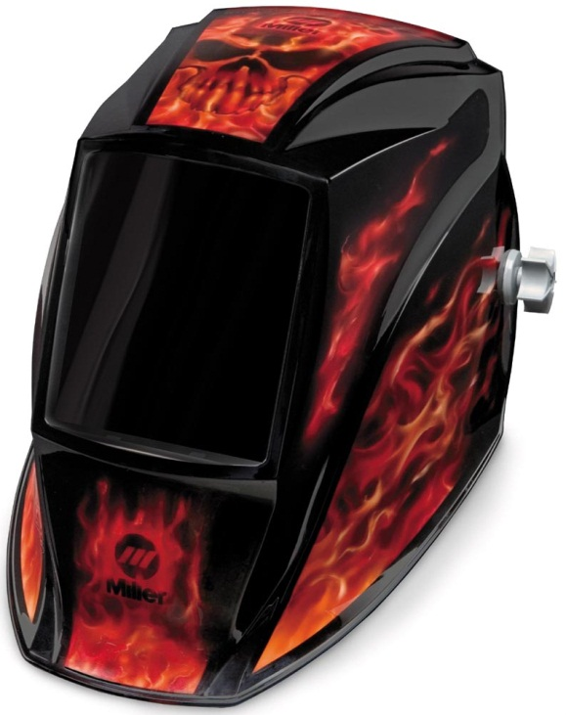
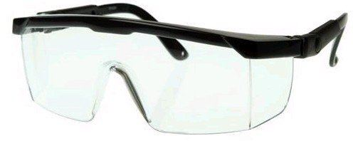
Eye and Face Protection
Helmet-Shade 10
Cover/Safety glasses-ANSI Z87.1 compliant
Face Shield
Notes:
The brilliant light given off by the electric arc produces invisible ultraviolet and infrared rays which can severely burn the eyes and skin.
NEVER LOOK AT THE ARC WITH THE NAKED EYE.
Helmets and shields are equipped with special filtered lenses that reduce the intensity of the light and prevent the ultraviolet and infrared rays from reaching the eyes. The welding helmet is designed specifically for the purpose of arc welding.
Shade 10 can be used when welding with 75-200 amperes. The highest shade available is Shade 14
Cover glasses-clear lenses that are used to stop flying slag or metal and should ALWAYS be worn in the shop. In the United States, the industry standard for welding helmets is ANSI Z87.1 which specifies performance of a wide variety of eye protection devices. The standard requires that auto-darkening helmets provide full protection against both UV and IR even when they are not in the darkened state. The standard is voluntary, so buyers should confirm that the helmet is ANSI Z87.1 compliant (indicated by appropriate labeling).
ALWAYS use a face shield when grinding, sawing, cutting and removing slag

Slide 10
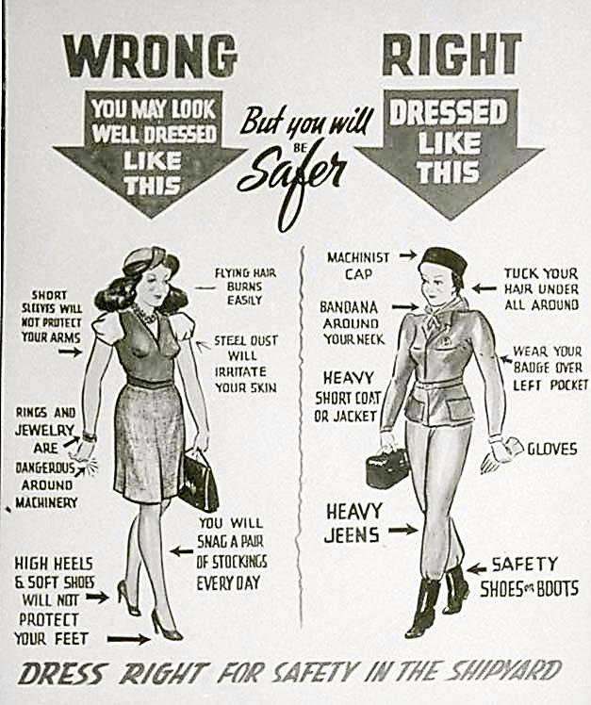
Safety Rules
Secure work
Avoid electrical shock
Protect others
Never weld in a damp area
Never wear synthetic fiber clothing
Protect welding cables
Notes:
Wear gloves and eye and face protection. The welder and all observers must wear welding helmets with a No. 10 or 12 filter lens. A welding cap or helmet with a hard hat is also recommended for head protection. When chipping slag or cleaning welds, wear a clear face shield or flip-up liftplate on the helmet.
Avoid electrical shock. Make certain that the electrode holder and all electrical connections and cables are properly insulated. Check to see that the welder is properly grounded. Do not dip the electrode holder in water to cool it because this practice may result in electrical shock.
Protect others. For small and practice welding jobs, work in a partitioned area to protect others from harmful rays. When prepared to strike the arc, inform all bystanders to cover their eyes.
Never weld in a damp area. Stand on a dry board or rubber mat if the floor or ground is damp or wet.
Never wear synthetic fiber clothing. Synthetic fibers are highly flammable. Wearing clothing made from wool or cotton is more satisfactory for welding because of their relatively high flash points.
Protect welding cables. Keep the cables from coming in contact with hot metal and sharp edges. Do not drive over cables. When welding, avoid wrapping electrode cables around your body.

Slide 11
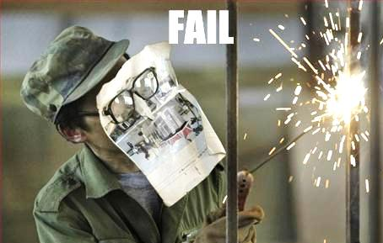
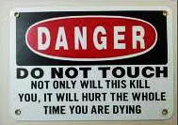
Safety Rules
Wear gloves and eye and proper face protection
Dispose of electrode stubs properly
Prevent burns
Do not let the electrode stick
Use both hands
Handle hot metal with pliers or tongs
Notes:
Secure work. Use a welding table with a positioner to hold welds securely in place. Clamps and vises can be used to hold odd-shaped work or field work. Securing work will also prevent injury from accidental dropping of metal on your feet or body.
Dispose of electrode stubs properly. Keep a container in the work area in which to deposit electrode stubs. This prevents burns to shoes or falls due to stubs rolling underfoot.
Prevent burns. Never allow the hot electrode or electrode holder to touch bare skin. Avoid letting the electrode touch a grounded cable. Remove hot metal from the work area when you are finished welding to prevent burns to others.
Do not let the electrode stick. If the electrode sticks, cut off the switch, allow the electrode to cool, and then break it loose with your gloved hand.
Use both hands. To reduce fatigue, use both hands for welding.
Handle hot metal with pliers or tongs. Submerge hot metal completely in water to prevent steam burns.

Slide 12
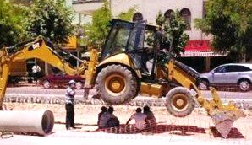
Safety Rules
Weld in a well-ventilated area
Do not carry matches or lighters, and do not allow bystanders to smoke
Notes:
Weld in a well-ventilated area. The fumes from lead, zinc, cadmium, and beryllium are toxic and may cause sickness or death.
Do not carry matches or lighters, and do not allow bystanders to smoke. Before welding, make sure the welding area is free of other flammables (gas, grease, etc.).

Slide 13
Knowledge Check!
What is the best material to use for protective clothing, footwear, and gloves?
Leather!
The darkest and most protective lens available for welding purposes is…
Shade 14!
Where is the best place to dispose of electrodes?
In A Container!

Slide 14
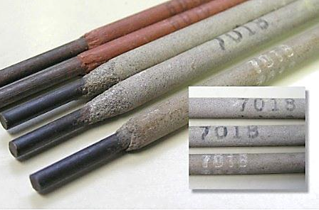
Classification of Electrodes
The American Welding Society (AWS) has developed the following electrode classification system:
  The E means that the electrode is used for electric arc welding
  The first two digits indicate the tensile strength
  The third digit tells you in what position the electrode can be used in
  The fourth digit indicates any special characteristics of the electrode
Notes:
The American Welding Society (AWS) has developed the following electrode
classification system:
a. The E means that the electrode is used for electric arc welding.
b. The first two digits indicate the tensile strength in thousands of
pounds per square inch (i.e., 70 means 70,000 psi).
c. The third digit tells you in what position the electrode can be used to weld
1=all positions
2= flat or horizontal only
3=flat only
d. The fourth digit indicates the special characteristics of the
electrode, such as type and general content of the coating, weld
quality, amount of penetration, and the type of arc or electrical
current. The fourth digit may be any number between 0 and 8. It
is important to note that the fourth digit cannot be considered
individually but must be considered in conjunction with the third
digit in order to identify both the polarity and position of the
electrode.

Slide 15
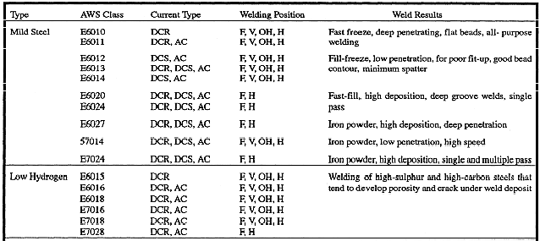
Electrode Selection Guide:
Notes:
Guides, like this one, are available in most shops to help you pick the best electrode for the job.
6010 and 7018 are important electrodes to note-Life, Limb and Property electrodes

Slide 16
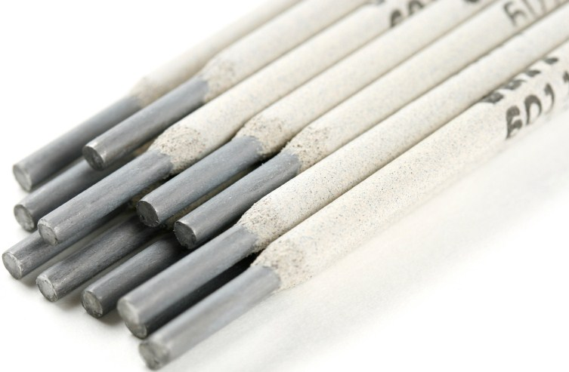
Choosing the Correct Electrode
The electrode should produce a weld metal approximately the same metallurgical properties as the parent metal.
Choose one that will provide good arc stability, fast deposition, maximum weld strength, minimum splatter, easy slag removal, and a smooth weld bead
  Electrode Diameter
  Joint Design
  Welding Position
  Type of Welding Current
Notes:
C. Selecting the Correct Electrode
1. The electrode should produce a weld metal with approximately the same metallurgical properties as the parent metal. A top quality weld should be as strong as the parent metal.
2. In selecting the best electrode for a particular welding situation, the aim is to choose one that will provide good arc stability, fast deposition, maximum weld strength, minimum splatter, easy slag removal, and a smooth weld bead. To achieve these characteristics from an electrode, the following factors should be considered:
a. Electrode Diameter - Generally, an electrode with a diameter larger than the thickness of the base material should not be used. If it is done, welding must be done at a very high speed and this requires considerable skill in order to obtain a sound weld. When making a vertical or overhead weld, a fast freeze type electrode with a diameter of 1/8" would normally be used.
b. Joint Design - This is another important factor to consider when choosing an electrode.
1) When welding a joint that is not beveled at the proper angle to allow easy penetration, consider using a deep penetrating, fast freeze electrode, for example, E-6010 or E-6011.
c. Welding Position - The welding position to be used during the deposition of the weld metal is a very important factor when selecting an electrode. Electrodes with a number 1 as their third digit will give better results in both the flat and the horizontal positions and a 3 will give good results in the flat position.
d. Type of Welding Current - This is another factor to consider when choosing an electrode. Some electrodes are designed for AC and DC straight or DC reverse polarity while others are designed to function properly using either AC or DC current

Slide 17
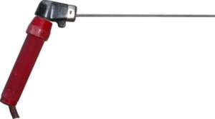
E-70-1-8
What does the ‘E’ stand for?
→ E means that the electrode is for electric arc welding
What do the next two numbers represent?
→ The tensile strength in thousands of psi
What does the third digit mean?
→ Electrode position
What does the fourth number tell you?
→ Electrodes special characteristics
Notes:
The E means that the electrode is used for electric arc welding.
The first two digits indicate the tensile strength in thousands of pounds per square inch-71,000psi
The third digit tells you the position that the electrode can be used in-all position
The fourth digit indicates the special characteristics of the electrode-AC or DC+ (reverse polarity)current and low hydrogen iron powder flux

Slide 18

FFA and SAE Welding Project Ideas:
Work in a welding shop that specializes in agricultural welding
Fabricate and weld a project for a fair
  Table or bench
  Forklift fork
  Art installation
Create a poster explaining the difference between different welding electrodes
Create a video demonstrating the importance of shop safety for your local Chapter to use

